Slide 1
Large Scale Text Analysis at LLNL
David Buttler
Text Analysis Working Group

Slide 2


LLNL Text Analytics helps analysts uncover novel information
We are working to speed understanding and triage of document streams
The techniques are based on advanced probabilistic topic models over large sets of documents
The products are advanced search tools
Bridge the gulf between the high-level goals and mental models of the analysts and the raw text
Make knowledge more available
Make analyst tasks faster
news
reports
messages

Slide 3

Faceted search is a foundational component for ad hoc document analysis

Slide 4
Current techniques are labor intensive, brittle, and error-prone
2 page boolean queries
Manually curated
Prone to become “black box”
Difficult to choose keywords that match documents
Query results show up as an undifferentiated list in analysts’ Inbox

Slide 5
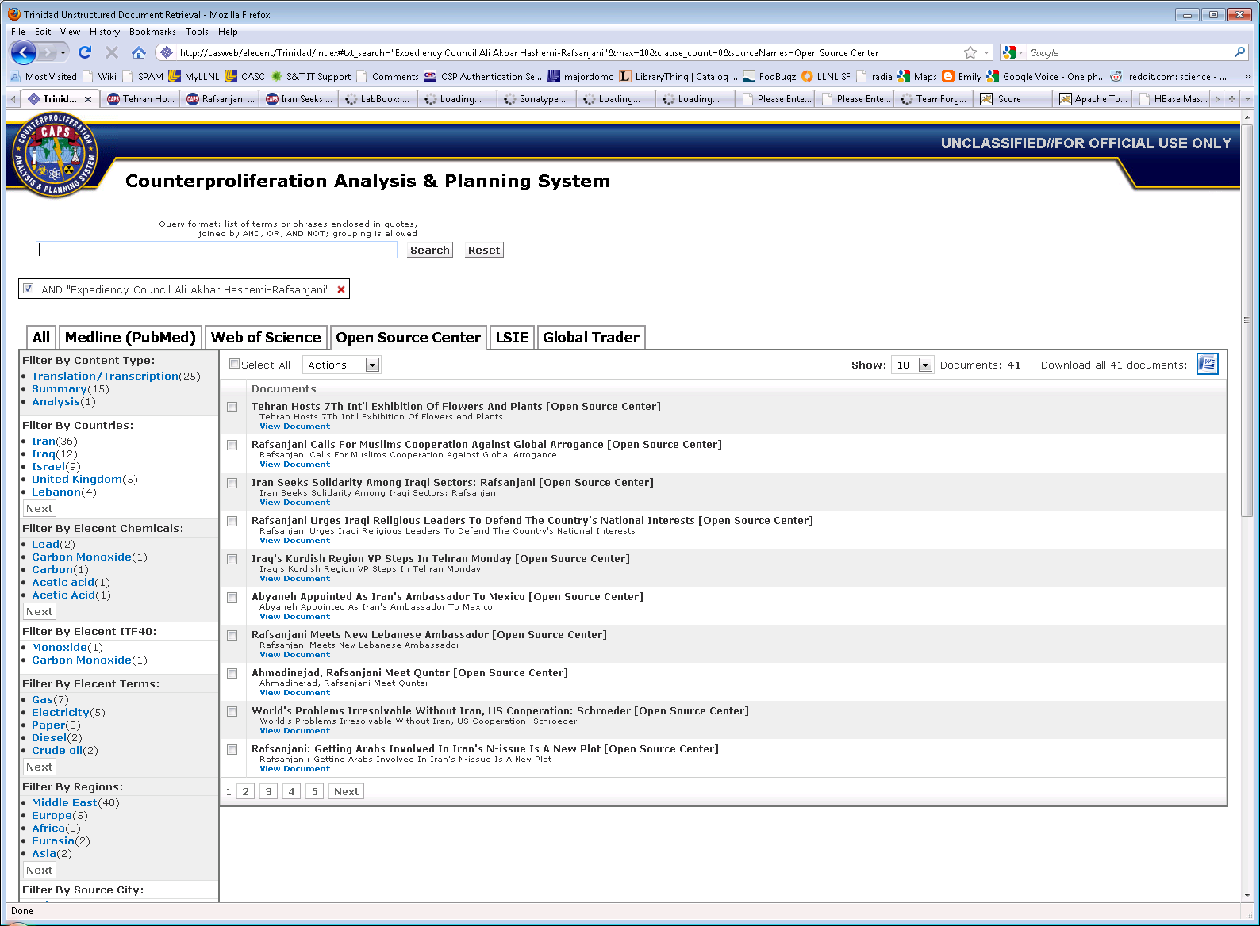
Our deployed technology provides immediate benefits and a platform to migrate research into production

Slide 6
Our research addresses four fundamental search challenges
Automatic Facet generation
Concept Hierarchy generation
Automatic result organization
ClusteringWiki
Assistance in generating targeted queries
Topic feedback
Ranking of results relative to specific tasks
iScore
We have a pipeline to move our technology into production
Trinidad

Slide 7
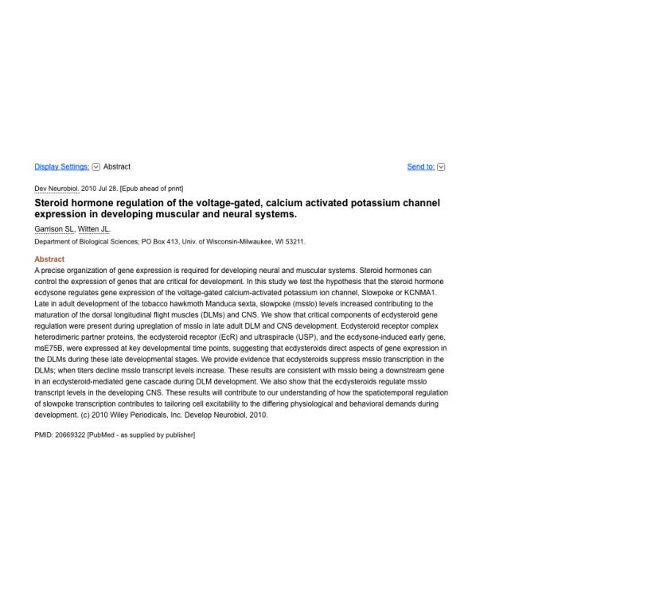
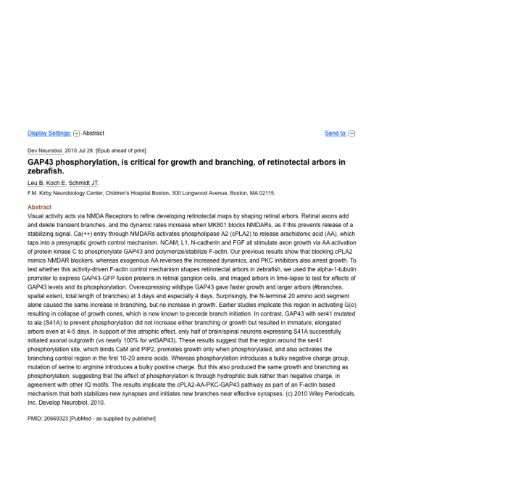
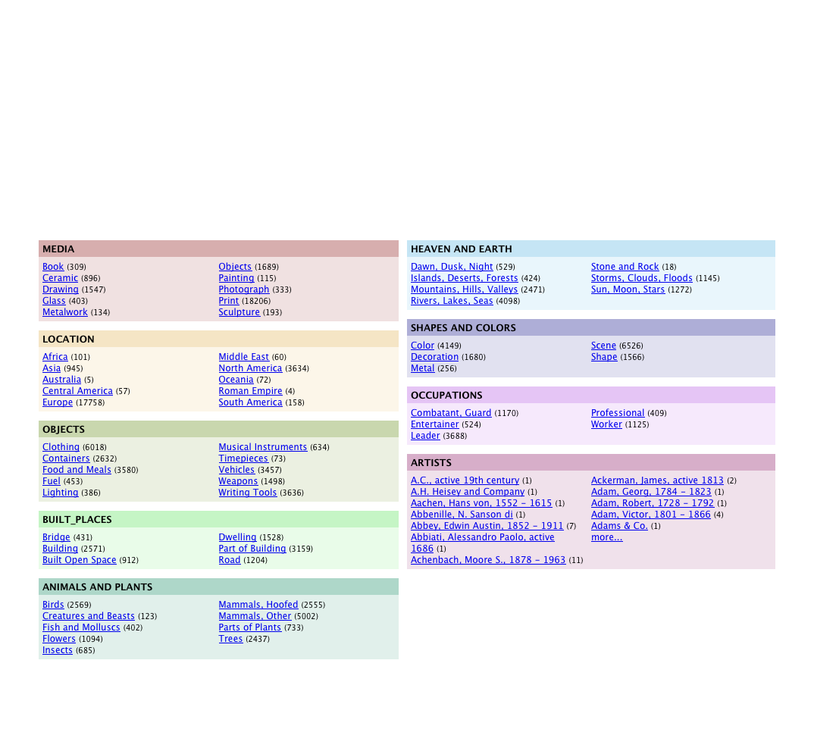
We generate facets without explicit metadata
Taxonomies provide an intuitive way to divide up a corpus
E.g. geographic regions
Most text does not come presorted into a relevant taxonomy
Each set of documents has unique features that do not fit into a predefined schema
Use word sense disambiguation to match terms to the taxonomy.
Learn new relations and condense known relations to make taxonomy applicable to specific corpus
Notes:
Existing taxonomies contain useful meanings, or senses, and relationships for frequently used terms but lack data for new or domain specific terms. How does one organize and navigate documents with new terms unknown to a taxonomy, and what if the taxonomy has more relations that needed for some terms? This research integrates two approaches for building customized taxonomies: learning new relations and condensing known relations.

Slide 8
What is a Taxonomy?
A highly organized dictionary
Maps words to concepts
Definitions
Relationships
Generalizations
Implications
Parts-of
Placental
Carnivore
Canine
Feline
Dog
Cat
A portion of the WordNet taxonomy

Slide 9
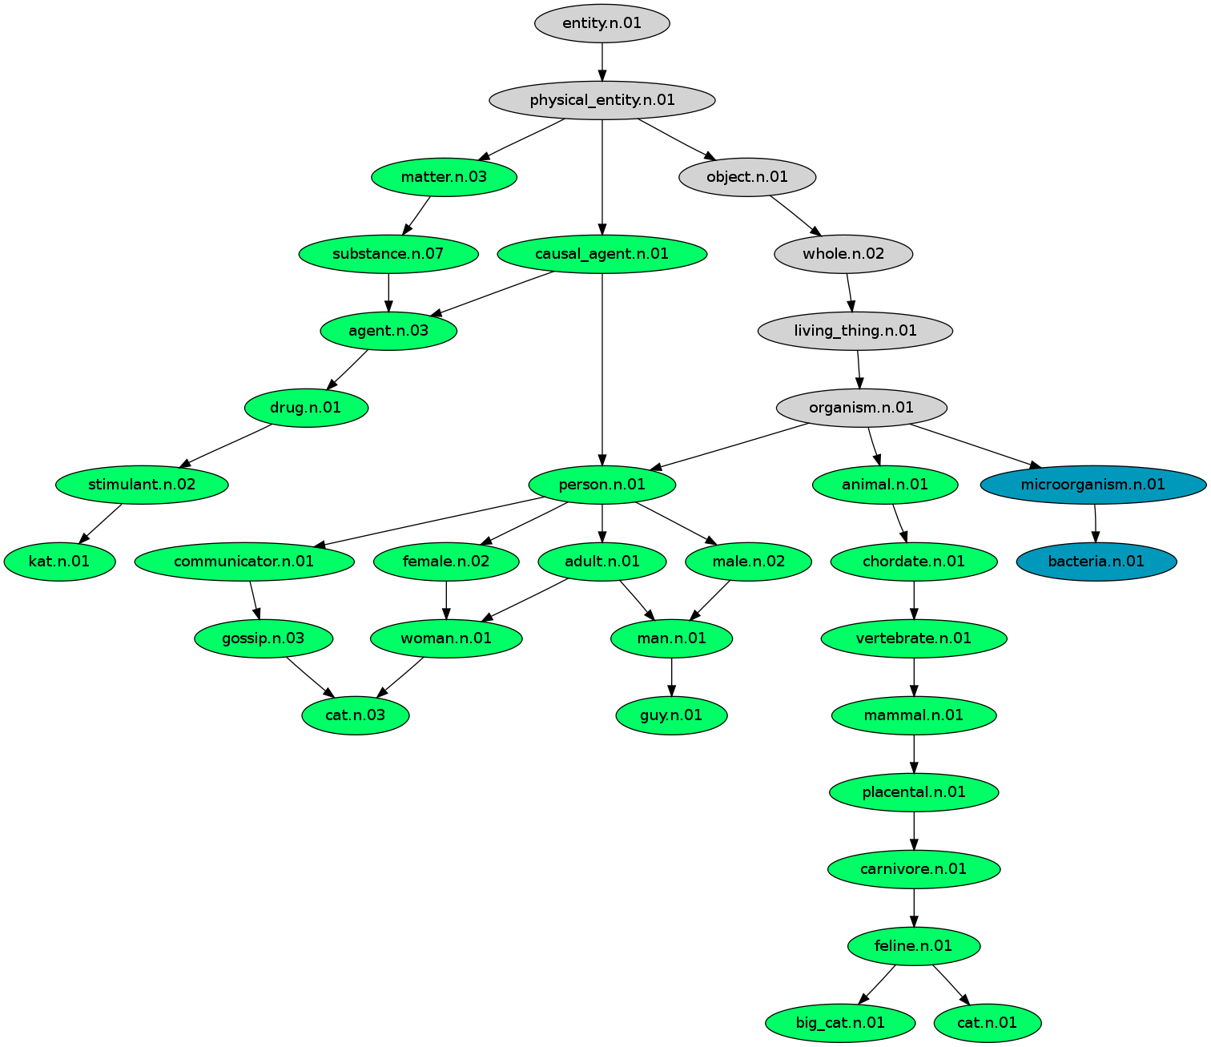
Facets need to be automatically targeted to the content of the documents
The Taxonomy has
8 Ways to define “Cat”
1 Way to define “Bacteria”
We May Want
1 Ways to define “Cat”
5 Way to define “Bacteria”
OR
We May Want
10 ways to define “Cat”
5 Way to define “Bacteria”

Slide 10
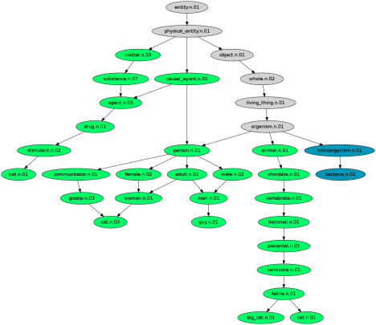
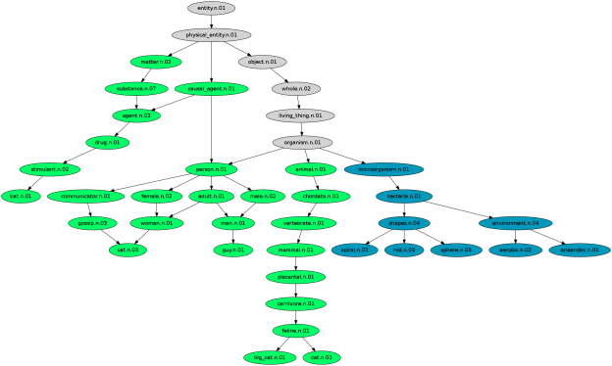
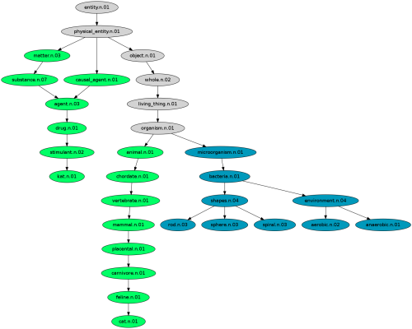
We are developing machine learning techniques to customize existing taxonomies
Step 1
Take a base taxonomy
Take a corpus
Step 2
Add new concepts from the corpus
Use a classifier to attach terms
Step 3
Remove unused concepts based on corpus statistics

Slide 11
The processing pipeline leverages our scalable text infrastructure
Extract Semantic Similarity
Evidence
BigTable
Add New Relations
Document Collection
Parse Documents
Doc BigTable
Extract Taxonomic Relations
Merge Redundant Relations
WordNet
Custom WordNet

Slide 12
Future Challenges
Online Updates
Can the taxonomy expand fluidly?
Can we extend these techniques to situations where we don’t have a large and rich base taxonomy?
Does a custom taxonomy allow us to improve related Natural Language Processing tasks
Better word sense disambiguation
Better Facet Generation
Better Information Retrieval

Slide 13
Our research addresses four fundamental search challenges
Automatic Facet generation
Concept Hierarchy generation
Automatic result organization
ClusteringWiki
Assistance in generating targeted queries
Topic feedback
Ranking of results relative to specific tasks
iScore
We have a pipeline to move our technology into production
Trinidad

Slide 14
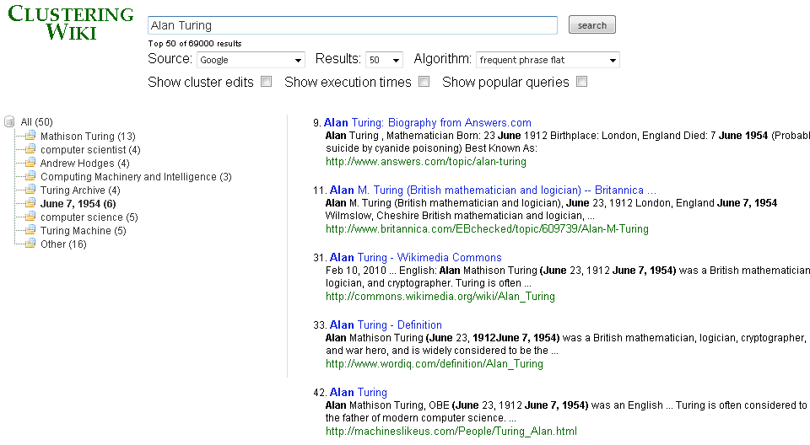
Clustering Wiki

Slide 15
Our research addresses four fundamental search challenges
Automatic Facet generation
Concept Hierarchy generation
Automatic result organization
ClusteringWiki
Assistance in generating targeted queries
Topic feedback
Ranking of results relative to specific tasks
iScore
We have a pipeline to move our technology into production
Trinidad

Slide 16
Text search with latent topic feedback improves relevance of search results
Goal: effectively navigate corpus of text documents (e.g., scientific articles, message traffic)
Problem: user may not know “right” keywords to use (e.g., junior SME)

Slide 17
Latent topic modeling provides semantic groupings of document themes
Unlike Amazon, we might not have nice metadata
Solution: automatically learn topics from documents
Latent Dirichlet Allocation model (Blei, et al)
Mallet software implementation
Relevant topics for TREC queries over Financial Times
User query | Topic label | Topic phrases / words
illegal technology transfer | arms | Matrix Churchill, Iraq, inquiry, Scott, gov’t
territorial waters dispute | petroleum | oil gas, North Sea, natural gas, production
euro opposition | emu | Maastricht treaty, monetary union, European

Slide 18
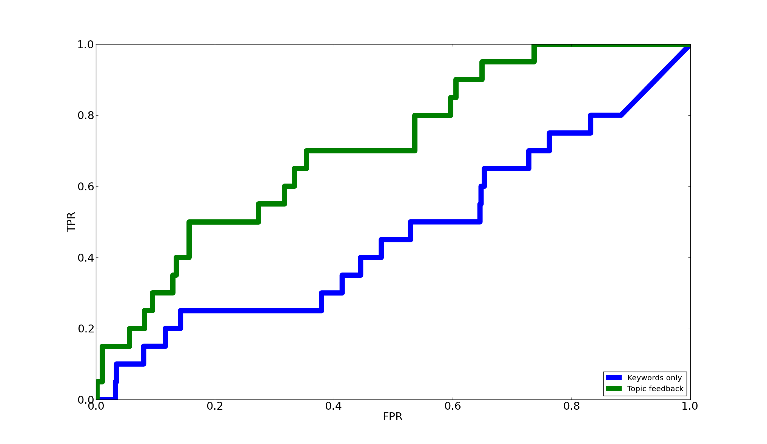
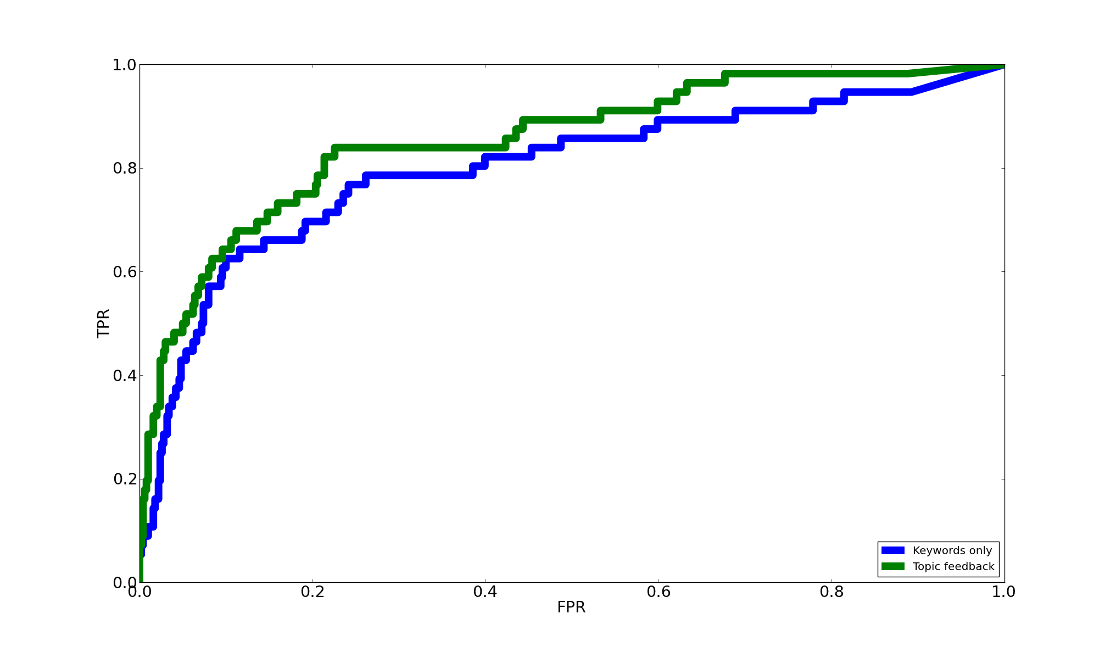
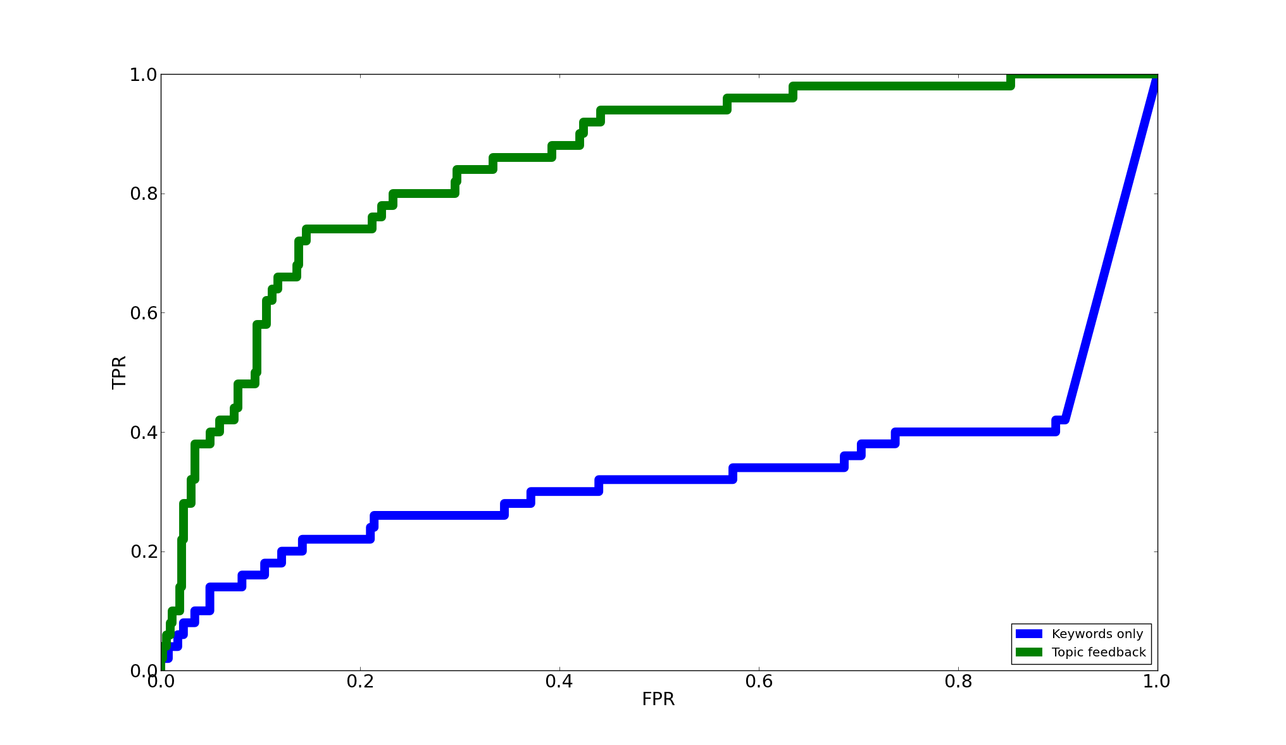
Topic feedback improves poorly formed queries
“Euro opposition”
“Territorial waters dispute”
“Illegal technology transfer”

Slide 19
Language model research is just beginning
Not all learned topics are this nice
Automatically evaluate topic “coherence”
Significant contribution in topic labeling
Will real user feedback improve results?
User studies
Further extensions
More topics
Hierarchical topics
Incorporate user knowledge into topics?
Improved Topic Labeling
Before: | war, world, ii, vietnam, years, american, veterans, battle, army, soldiers
After: | (veterans) World War II Pearl Harbor, civil war Vietnam, years, American, battle
Improved Topic Labeling
Before: | war, world, ii, vietnam, years, american, veterans, battle, army, soldiers

Slide 20
Our research addresses four fundamental search challenges
Automatic Facet generation
Concept Hierarchy generation
Automatic result organization
ClusteringWiki
Assistance in generating targeted queries
Topic feedback
Ranking of results relative to specific tasks
iScore
We have a pipeline to move our technology into production
Trinidad

Slide 21
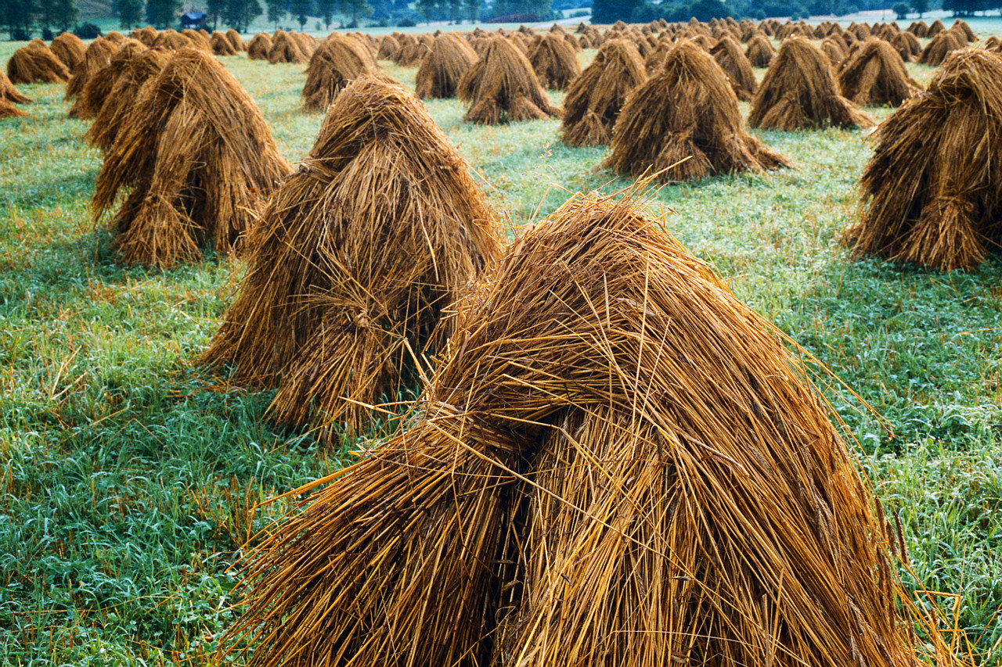
iScore – Finding a Needle in a Haystack
We need a way to find
Why an article is interesting?
Which articles are interesting?
Requirements
Online
High Precision
Few users
Notes:
So the problem we’re dealing is the proverbial needle in the haystack. We have a lot of news and only a few are interesting. So we want to find out why an article is interesting and as a result we can figure out which articles are interesting. (animate) But we have some constraints. Any solution to this problem has to be done in a somewhat online and single-pass fashion because news articles are constantly being published so any solution would have to suggest articles fast enough such that the user still considers the article interesting. Users certainly would not want to read about old news. The suggestions given to the user should be of high quality as well. If the results are poor, users will stop using the system. And because we’re working in a small user environment, methods like collaborative filtering would not work.
Filtering based on only topic relevancy is insufficient for identifying interesting articles
No single feature can characterize the interestingness of an article for a user
Through user-feedback, a classifier can combine features to predict interestingness for the user

Slide 22
iScore builds a task profile to suggest more relevant documents first
Computes the probability of the article being interesting to a user given its features {F₁,F₂,…F_{n}}
F₁
Adaptive
Thresholding
Yes
New
Article
F₂
Updateable
Classifier
iScore
No
…
F_{n}
Interesting?
Weak Feature Extraction
Documents are processed from either a stream or search results
Notes:
Features for interestingness
Ensemble technique
Multiple topic tracking
Online parameter selection
Online feature selection
Improve baseline IR techniques by as much as 50%
To better illustrate our approach, let’s go through the classification pipeline. It follows the same experimental setup as the TREC adaptive filter task. (animate) We start out with an article, which is then processed by a set of weak feature extractors. (animate) These feature extractors generate scores or values which are used as inputs into an updateable classifier. (animate) The classifier then generates the probability that the article is interesting, which we refer to as an iScore. (animate) Then an adaptive thresholding component thresholds the iScore to generate a final binary classification to the user. The user then in turn reads the article and provides the system with his own binary classification, or tagging, which is then used to update the feature extractors and the classifier.

Slide 23
Comparisons
Traditional IR Classifiers
Rocchio Variant
Language Modeling Classifier
Individual iScore Feature Extractors
MTT
eRocchio
iScore Ensemble
Feature Selection
Notes:
We compare iScore with some standard IR techniques, such as the Rocchio variant that best performed in TREC, and the language modelling classifier provided by Lingpipe. We also compare iScore to some of our base features, such as MTT and eRocchio. Additionally, the current version of iScore is compared with the first version of iScore. The difference between the new iScore and the original iScore is that the new iScore includes MTT, eRocchio, Phrase Interestingness, Topic Driven Freshness, Language Models for titles and bodies, cluster movement, sliding anomaly detection, and online feature selection.

Slide 24
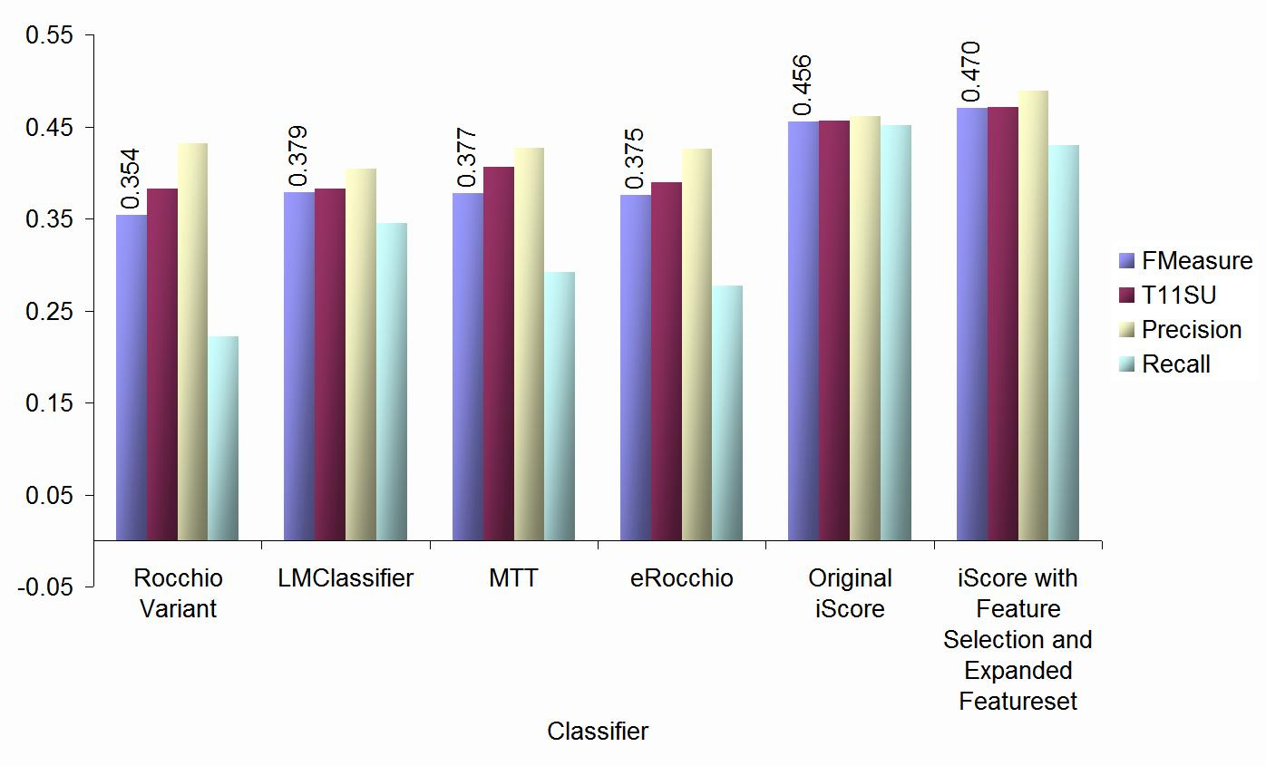
Tests on Yahoo! News shows significant performance improvement over strong baselines
+24%
Notes:
Here, we see the FMeasure in blue, T11SU in red, precision in yellow, and recall in green. (animate) What we are primarily interested in is the performance of iScore with feature selection and our expanded featureset, which includes all the features I have researched up to this date. (animate) In this case, we see that iScore beats the best baseline, the language modelling classifier by 24% on average.
Metrics: precision, recall, F1, T11SU (Linear weighting of correct and incorrect recommendations )

Slide 25
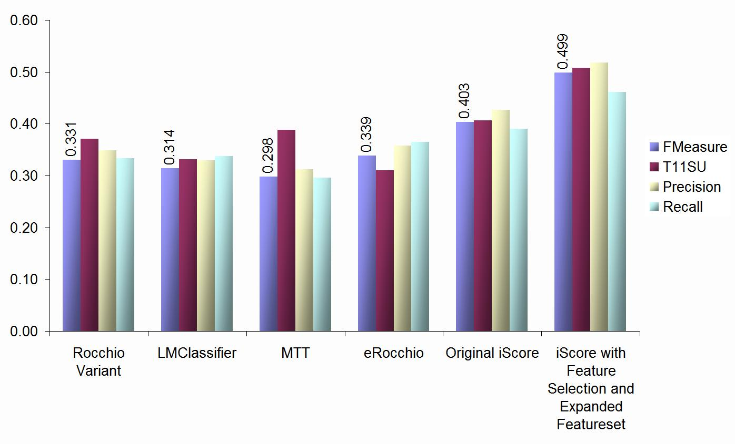
Real user studies show a 50% improvement in performance
+50%
Notes:
Here, we have the average FMeasure, T11SU, Precision, and recall of each classifier for the tagger dataset. (animate) I’m highlighting our latest iScore configuration. (animate) For the new iScore, it performs 50% better than the best traditional classifier.

Slide 26
Our research addresses four fundamental search challenges
Automatic Facet generation
Concept Hierarchy generation
Automatic result organization
ClusteringWiki
Assistance in generating targeted queries
Topic feedback
Ranking of results relative to specific tasks
iScore
We have a pipeline to move our technology into production
Trinidad

Slide 27
Hadoop provides a research platform for large scale data intensive computing with commodity hardware
Problem: archive, index, and serve O(1B) records
Daily stream of new messages / news articles
Random data dumps
Requires supporting
ad hoc and recurring queries
Process models
Solution:
Web standards
open source software
Custom GUI’s tailored to specific user needs
LLNL research
Notes:
Focuses on cheap (~$3K / node) hardware
Quad core dual processor
4-24 GB RAM
2-4 local hard disks (1 TB each)
Walk you through the hadoop ecosystem. You should understand what it is good for and what it is not good for by the end
And then I will talk about how we use it in a couple of different projects at the lab

Slide 28
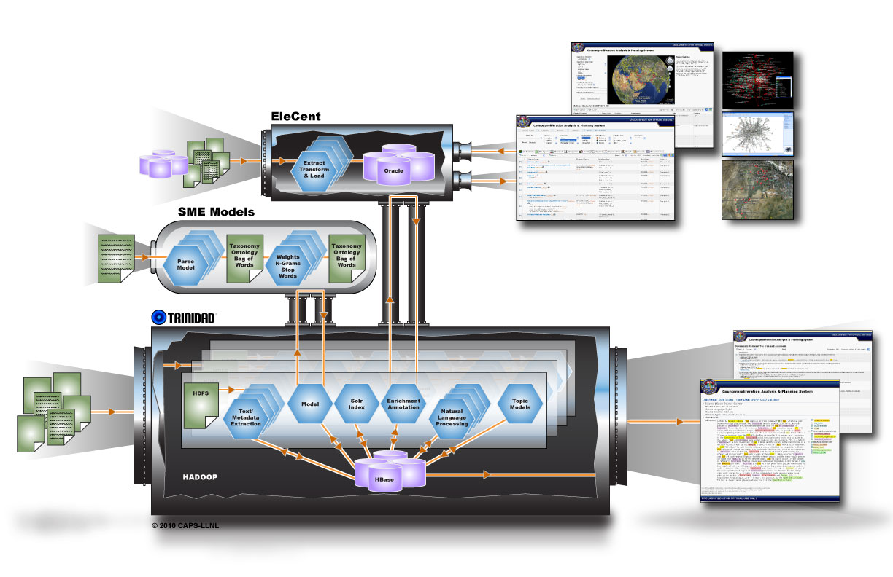
Trinidad software architecture integrates structured domain knowledge with unstructured document sources
Research Contributions

Slide 29
Keyword tagging & Entity extraction are core components of the Trinidad document management system
Keyword tagging
Large dictionaries (100K terms)
Finite state machine to store dictionary
Named Entity Recognition
[People, Organizations, Location]
Stanford NER
CRF model
UIUC NER
Trained model incorporating wikipedia dictionaries
21M Pubmed entries + 1M news articles
11M Pubmed abstracts
55K dictionary key phrases
cluster 6 x [16 core, 96 GB RAM, 6 TB disk]
Keyword Tagging
8 minutes, 34 seconds
5.7M annotations
Named Entity Annotation
1 hr 58 minutes
9M annotations
Notes:
Embarrassingly parallel applications that are heavily I/O bound

Slide 30
Fast data indexing allows us to constantly tune indexes to analyst tasks
Creating 6 Solr index shards on 500M records (~2K/ record):
Approximately 2 hrs
Map jobs publishing to 6 existing shards
Current ingest rate of mail messages with naïve pipeline:
~200 messages / update
~7 minutes for UIUC NER tagger
~1 minute for Stanford NER tagger
~30 seconds for keyword list
~30 seconds to publish & update index
1M messages in index

Slide 31
Custom GUIs are the key for extracting value from data

Slide 32
Custom GUIs are the key for extracting value from data
1&2. Hierarchical Facets / ClusteringWiki

Slide 33
Custom GUIs are the key for extracting value from data
3.Query Feedback

Slide 34
Custom GUIs are the key for extracting value from data
4. Ranking

Slide 35
This work is in collaboration with many groups
Internal
David Andrzejewski (LLNL Postdoc)
Keith Stevens ( UCLA / Lawrence Scholar Program)
CPOIS software development team
BKC
External
Andrew McCallum (U. Mass-Amherst) – Language models
Byron Gao (Texas State) -- ClusteringWiki
Ray Pon (UCLA / Lawrence Scholar Program alum / Microsoft )
Ellen Riloff (U. Utah) – coreference platform
Claire Cardie (Cornell) – coreference platform

Slide 36
Lessons Learned
Hadoop / HBase / Solr all scale very well
Better to have multiple task-specific clusters
Many different types of data can be mixed
Bottlenecks are mostly in I/O not CPU
Rapidly evolving technology
Everything gets better quickly
Requires an agile group to track changes

Slide 37
Questions?
Disclaimer
This document was prepared as an account of work sponsored by an agency of the United States government. Neither the United States government nor Lawrence Livermore National Security, LLC, nor any of their employees makes any warranty, expressed or implied, or assumes any legal liability or responsibility for the accuracy, completeness, or usefulness of any information, apparatus, product, or process disclosed, or represents that its use would not infringe privately owned rights. Reference herein to any specific commercial product, process, or service by trade name, trademark, manufacturer, or otherwise does not necessarily constitute or imply its endorsement, recommendation, or favoring by the United States government or Lawrence Livermore National Security, LLC. The views and opinions of authors expressed herein do not necessarily state or reflect those of the United States government or Lawrence Livermore National Security, LLC, and shall not be used for advertising or product endorsement purposes.

